Slide 1
High Performance Data Warehouse
Design and Construction
Dimensional Modeling,
Summary versus Detail Data

Slide 2
Objectives
Clearly distinguish between dimensional modeling as a logical design technique versus physical database design options.
Evaluate options for physical database design for ROLAP tools.
Evaluate options for primary key construction in physical database designs.
Notes:
There is plenty of confusion regarding logical versus physical data modeling in the OLAP environment. We will attempt to untangle these two very important topics with specific examples and distinction between dimensional modeling and physical deployment of a dimensional model.

Slide 3
Topics
Dimensional modeling.
Physical database design for ROLAP deployment.
Natural versus surrogate key designs.

Slide 4
Dimensional Modeling
Use dimensions, levels, facts, and metrics to construct logical data models to support analytical (often ROLAP) applications.
Dimensions and Levels for organization (qualitative, collective).
Facts for measurement (quantitative).
Notes:
Dimensional modeling is a valuable tool for helping to organize data in a way that is suitable for analytic purposes. It is important to understand that dimensional modeling is for logical organization of data and should not dictate a specific physical design.

Slide 5
Dimensional Modeling
Rules more restrictive than for E-R modeling.
Simpler logical model.
E-R representative power greater due to variety of constructs supported.
Looks like normalized E-R conceptual, except:
  All relationships mandatory M-1.
  Single path between any two levels.
Notes:
Dimensional modeling is a cousin to traditional data modeling a la Chen’s Entity-Relationship diagrams. The defining difference between dimensional modeling and E-R modeling is that many-to-many relationships are not “allowed” in dimensional modeling.
Business rules are used to replace many-to-many relationships with many-to-one relationships. For example, cough drops as a product may be associated to both the “candy” and “medicinal” product categories. To create a one-to-many relationship from this type of many-to-many relationship, a business rule to assign a “primary” product category would be put into place. Multiple “versions” of the dimensional hierarchy would be instantiated if different aspects of the many-to-many relationship were “primary” for different purposes.
It is important to eliminate many-to-many relationships in a dimensional model so that double counting does not take place when rolling detailed data into higher levels in the dimensional hierarchy. A single path between any two levels in the dimensional hierarchy guarantees that double counting will not take place.

Slide 6
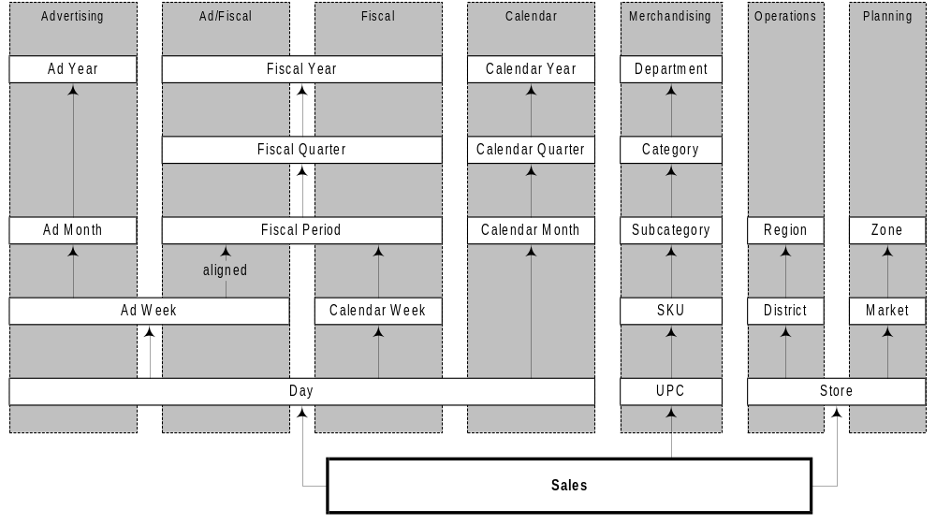
Example Retail Dimensions
Notes:
This example shows a simplified dimensional model for a retail environment. Sales facts have three main dimensions of analysis: geography (store at the most detailed level), product (UPC at the most detailed level), and calendar (day at the most detailed level). All relationships are one-to-many going from top to bottom in the hierarchy diagram.
Notice that a dimension may have many “flavors” to it. The geography dimension has a operational flavor and a marketing flavor. The calendar dimension has advertising, fiscal, and traditional calendar flavors.
The calendar dimension also has a hybrid dimension between advertising and fiscal flavors to allow drill down using the fiscal calendar though to ad weeks as a path to individual days. Business rules are used to assign ad weeks to fiscal periods when ad weeks cross fiscal period boundaries. This type of “alignment” is often used to allow drill down when the relationship from a lower level in the dimensional hierarchy to an entry in the higher level is ambiguous (as is the case with ad weeks that do not necessarily end on fiscal period boundaries).

Slide 7
Actual, Accumulated, and Allowable Events
Actual Events are tied to actual transactions (e.g., sales).
Accumulated Events are the effect of accumulated transactions (e.g., inventory on hand).
Allowable Events represent the “ability” to perform a transaction (e.g., carried products, a.k.a. plan-o-gram).
Actual Events are typically more sparse than allowable events (e.g., a store carries more products than it sells each day). Choices in data representation will dictate relative size in the physical design.
Notes:
Fact entities are often associated to events. Events have many different variations. Actual events are the most intuitive because they represent tangible business transactions.
Accumulated events are the result of multiple actual events. For example, inventory on hand (IOH) is the result of the accumulated effects from supplier receipts/returns, customer purchases/returns, inventory adjustments for shrink, and so on. At some level, we can consider accumulated events to be an aggregate denormalization of actual events. However, unless we have all actual events from the beginning of time, accumulated events are required as a distinct entity to keep track of current state for the accumulation.
Allowable events keep track of what is “allowed” to happen even when current state precludes such events. For example, a store plan-o-gram may allow us to sell salsa, but if we have zero inventory on hand we clearly will not be in a position to do so.
Using date segmentation (start and end dates) can make storing accumulated and allowable events very efficient in storage terms, but typically performs poorly with commercially available query tools because the date logic is too sophisticated for efficient SQL generation.

Slide 8
Physical Dimension Representations
Choice often determined by front-end tool and/or RDBMS technology.
Four alternatives:
  Normalized (snowflake schema).
  Flattened (denormalized, star schema).
  Expanded (hybrid of normalized and flattened).
  Levelized (used by Information Advantage).
Additional tool-specific requirements will apply, especially in the calendar dimension.
Notes:
Dimensional modeling is a logical database design technique, but eventually we will want to physicalize the design. Your choice of front-end tool and RDBMS will influence your physical design choices in a big way. We will see examples of this as we examine various options for physicalizing the dimensional model.
It is especially important to understand front-end tool requirements for representing dimensional data. The most intricate requirements for physical design are typically found in the calendar dimension (to facilitate frameworks to identify current day, week, period, etc. as well as TYLY comparisons).
Note: TYLY = “This Year to Last Year”

Slide 9
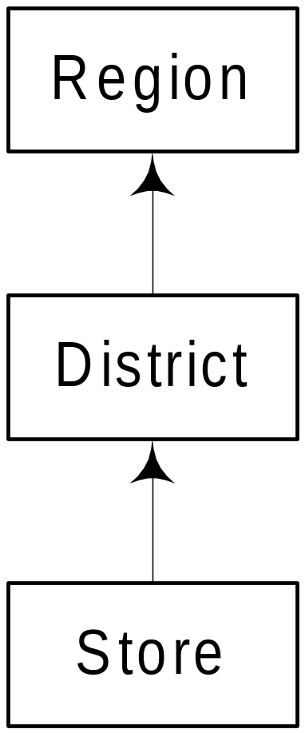
Example Dimension
Simple retail geographical location dimension.
Three levels, strictly hierarchical.
Note: Examples to follow show usage of tables and columns, not actual physical names and types.
Notes:
To illustrate differences in physical database design, we will use a simple geographic hierarchy. Assume that a region contains many districts and that districts contain many stores (e.g., one-to-many relationships in a strict hierarchy). Your dimensional models will be more complicated than this simple example, but the physical design techniques will carry across.

Slide 10
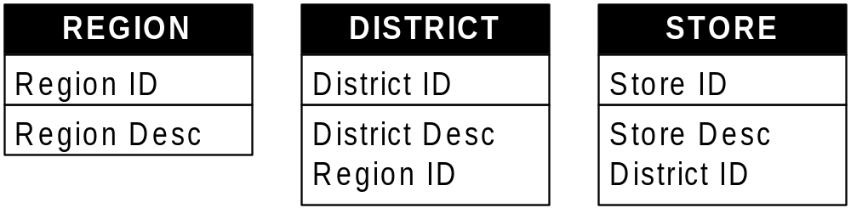
Normalized Dimension
(SnowFlake)
One table for each level:
One column for each attribute of the level.
One column (foreign key) for each ‘upwards’ arc.
One row for each instance of the level.
Notes:
The normalized design explicitly preserves the relationships between each level of the dimensional hierarchy. There is zero data redundancy and the physical data model is basically identical to the logical data model. The normalized design, when it corresponds to direct physical mapping of the logical design for a dimensional model, is usually referred to as a snowflake schema. This is the type of physical data model preferred by MicroStrategy because the physical data model accurately reflects the business relationships in the data - thus making the drill through paths for the tool explicit. The normalized design is also well suited to the Teradata RDBMS, but not so much to other database products because the normalized design requires a more sophisticated optimizer (to derive optimal join plans with many small table joins). Informix and mainframe DB2 also handle the normalized dimension model relatively efficiently.

Slide 11
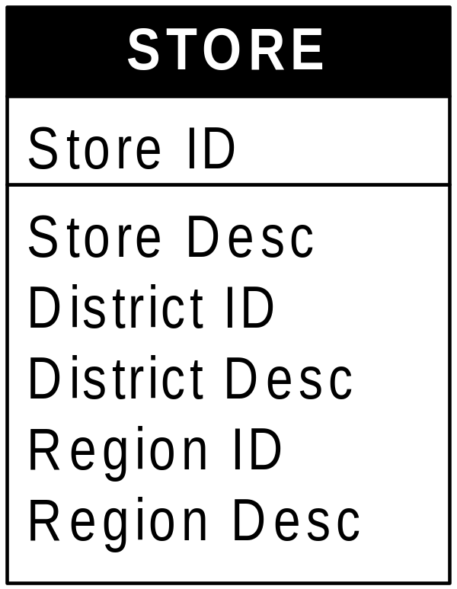
Flattened Dimension (Star)
Single table:
One column for each attribute of each level.
One row for each instance of the lowest level.
Note: If there are fact groups at other than the lowest level, supplementary tables will be required.
Notes:
The flattened dimension is the classic “star schema” approach. All the information for all levels in the hierarchy are in a single table. This is the simplest table design and is heavily promoted by Red Brick and Oracle as a means of eliminating joins from query execution plans. Unfortunately, business meaning is lost when relationships in the dimensional hierarchy are eliminated. Red Brick requires the flattened dimension design because of the way its optimizer and indexing strategies work. The joins with small tables are nearly “free” in execution time in an Oracle environment when an appropriate plan is generated by the optimizer, but optimizer hints are typically required to get a desirable plan with Oracle when lots of tables are present in a query due to lack of optimizer sophistication - and hints are impractical for most tools generating SQL because human intervention is typically required to get the hints right. DB2 UDB EEE (parallel DB2 for UNIX and NT) prefers the flattened dimensions because of how its indexing strategy works and because small tables usually need to be duplicated for each database partition for high performance (more on that later). SQL Server prefers flattened dimensions because it lacks sophisticated parallelization capability in its join strategies, so fewer joins is highly desirable. Note that any database product that can handle the normalized (snowflake) design will have no problem handling the flattened design because the flattened design is a much simpler optimization problem.

Slide 12
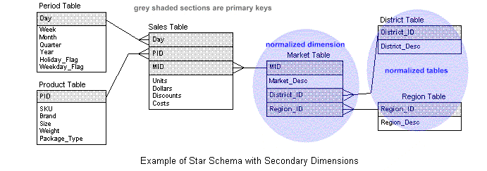
Star Schema with Flavored Dimension

Slide 13
Multi Star Schema
A star schema where the concatenated FKs might not provide a PK
A fact table contains a degenerated dimension (e.g., line_num)
Degenerate Dimensions
When the grain of a fact table is line-item
  Order number is a degenerated dimension.
  The PK of the fact table consists of all FKs + degenerated_dimension + line_item.
Occurs in Order, Invoice, Bill of lading, ticket
The degenerated dimension key should be the actual production order number.
The schema with a degenerated dimension is called a multi-star schema.

Slide 14
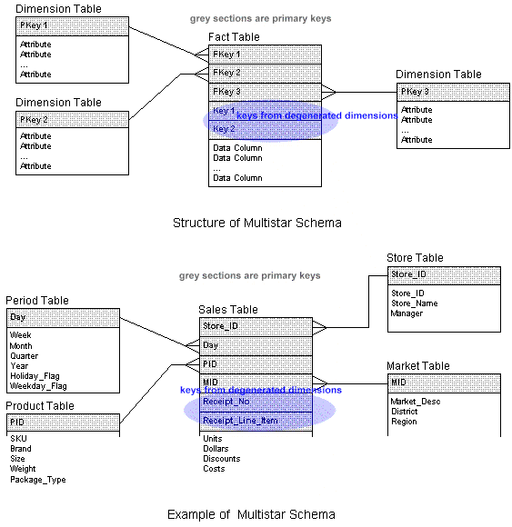
Multi Star Schema

Slide 15
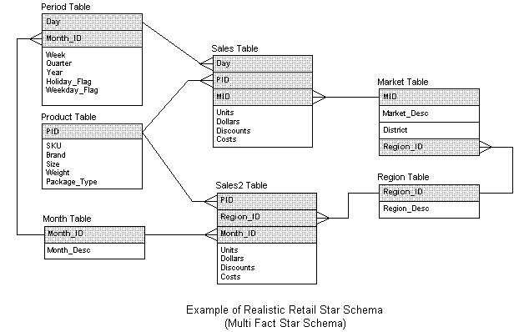
Multi Fact Star Schema
Many fact tables with one or more dimensions in common
Use conformed dimensions
Conformed dimensions support drill-across operations

Slide 16
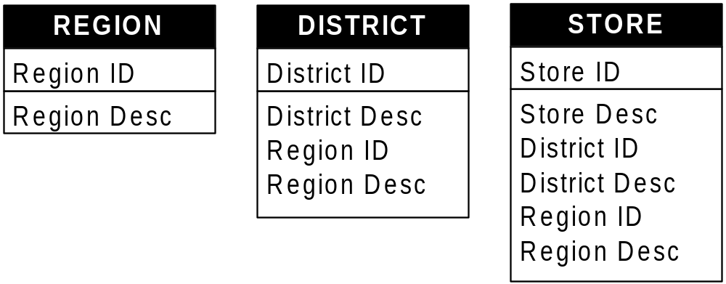
Expanded Dimension (StarFlake)
One table per level:
Each table like a flattened version of the dimension starting from the lowest level in the table.
All attributes for level and all levels above appear.
Maximum number of tables, maximum number of columns.
Notes:
The expanded design is somewhat of a hybrid between the normalized and flattened designs. A table is kept for each level in the hierarchy and relationships between levels in the hierarchy are preserved through use of foreign keys between the tables (as in the normalized design). In addition, however, all information from higher levels in the hierarchy is denormalized to all lower levels in the hierarchy. Thus, each level of the hierarchy looks like the flattened version of the table design for its particular level in the hierarchy.
This approach has the highest requirements in terms of storage because information is replicated at each level of the hierarchy. However, this approach also has the most generality in terms of working with tools because relationships are preserved through use of foreign keys at the same time as join paths are eliminated between levels through use of denormalization.

Slide 17
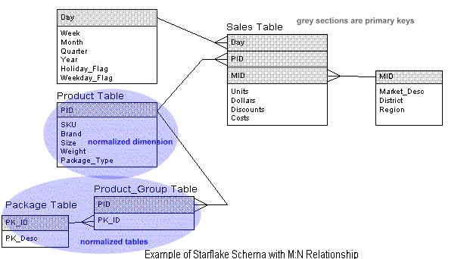
StarFlake with M:N Relatioship

Slide 18
Levelized Dimension
One table with all the columns of the flattened dimension, plus a few additional special columns.
  One row for each instance of each level.
#Tables = flattened
#Columns > flattened
#Rows = total of all normalized tables
Notes:
The levelized design is very specific to the Information Advantage tool (recently acquired by CA). This design is sort of like the expanded design where all rows from each level in the hierarchy are placed into a single table. The table is extended with additional columns to capture information about the level to which each row corresponds.

Slide 19
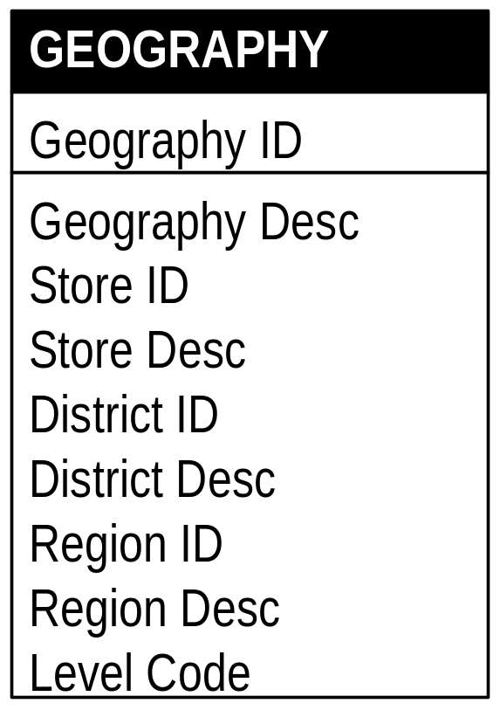
Levelized Dimension (cont.)
Artificial dimension id.
Dimension description.
Level code.
Columns NULL when not applicable (such as for the store columns in a district row).
Notes:
An artificial (surrogate) key is generated for each row at each level of the hierarchy for placement in the levelized table. The level code attribute (invisible to end users) is used by the tool to determine which level each row corresponds to in the hierarchy since the foreign key relationships between entries in each level are lost in this flattened design approach.
Note that no tool other than the Information Advantage application will be able to easily make use of these dimension tables. Also note that the artificial keys must be used in the fact tables for linking into the dimension tables.

Slide 20
Slowly Changing Dimensions
Potential changes of dimensions over time in Customer or Product
PKs do not change, but the description of the product or customer may change:
  Customers are changing address, income, marital status, credit level, etc.
  Sales forces change the names of districts and regions

Slide 21
Slowly Changing Dimensions
Three Approaches
Type 1 Changes: Correction of Errors
Overwrite the old value in the dimension record
Lose the ability to track the old history.
Use when the old value has no significance
Correct errors

Slide 22
Slowly Changing Dimensions
Type 2 Changes: Preservation of History
Add an additional dimension record using a new surrogate key value.
Segment history.
Track the change in an attribute within a dimension.
Represents a true "physical" change to the dimension entity.
Need to use a surrogate key
May use an effective begin date and an end date

Slide 23
Slowly Changing Dimensions
Type 3 Changes: Tentative Soft Revisions
Add an "old" field within the original dimension to record the immediate previous attribute value
Does not segment history.
Used in "soft" or "tentative" change as in redefinition of product category boundaries.
Used when we wish to keep tracking history with both old and new values.
Also add Effective_Date field.
Rarely used

Slide 24
Rapidly Changing Small Dimensions
Type 2 technique is still recommended

Slide 25
Large Dimensions
Two big dimensions with potentially several million records: Customer and Product
Issues:
  Support rapid browsing of the unconstrained dimension
  Support efficient browsing of cross-constrained values
  Query processing with the large dimension
  Find and suppress duplicate entries in the dimension
  Creating additional records to handle the slowly changing dimensions

Slide 26
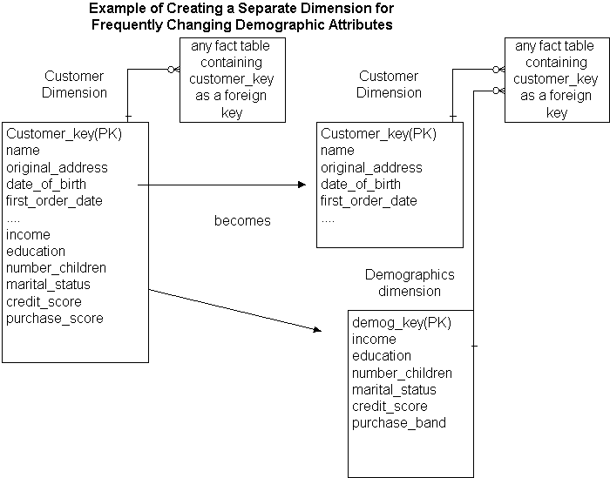

Slide 27
Additivity of Measures
Additivity: add the facts along all of the dimensions
Numerical measures of intensity are not always additive.
  Ex: Account balance, inventory level
  They are additive along all the dimensions except time.
  Fully-additive
  Semi-additive
  Non-additive

Slide 28
Additivity of Measures
Fully-additive
Can add across any dimensions
Ex: sales_dollars, cost, qty_sold, margin_dollars

Slide 29
Additivity of Measures
2. Semi-additive
Can add across some dimensions, but not all
Semi-additivity occurs when measures represent levels.
Semiadditive facts must be averaged across time when used across time.
Ex: bank_balance, head_counts, invenstory_quantities
. All balances can be added over all accounts for each branch.
. All balances can be added for all accounts for each customer.
. Balances cannot be added over time; we have to divide the sum by #days

Slide 30
Additivity of Measures
3- Non-additive
Can’t add across dimensions
Percentages (or rates) are non-additive.
Temperatures are non-additive.
Ex: margin_rate
Break down into additive components
(Keep Margin_dollars and Sales_Dollars, instead of Margin_rate)

Slide 31
The Four-Step Design Method for Design a Fact Table
1. Step 1: Choosing the data mart
Start with a single-source data mart, not multiple-source one.
2. Step 2: Decide the fact table grain
Choose as low-grain as possible
- The lower the level of granularity, the more robust the design
- Easily handle unexpected queries and additional new data elements

Slide 32
Examples
- Individual transaction level
. Each sales transaction
. Each insurance claim
. Each ATM transaction
- Individual snapshot level
. Each daily product sales total in each store
. Each monthly account snapshot
- Line_item level
. Each line-item on each order(shipment's invoice)
. Each coverage in each individual insurance level

Slide 33
3. Step 3: Choosing the dimensions
The best dimensions are the single-valued descriptors attached to a set of measurements.
The granularity of a dimension cannot be lower than the fact table granularity
The granularity of a dimension could be higher than the fact table granularity.
Example: Fact: Month level
Time dimension: can be year, but not daily level
4. Step 4: Choose the facts
Facts should always be specified to the grain of the fact table
Aggregate or summary data should be in different records and different fact tables

Slide 34
Dimensional Modeling
Query tools usually require hierarchical relationships to avoid double counting when drill down functionality is supported with automated SQL generation.
Dimensional modeling is a logical modeling technique that produces models that naturally support these tools.
Easier to arrive a final usable model when DM techniques are used early to simplify represented relationships.
Flattened representation is most discussed in literature, but all are valid physical representations.
DM is a logical technique, star-schema is a physical representation. DM per se does not dictate flattened dimensions.
Notes:
SQL generation must be fully generalized and automated to facilitate deployment of user friendly query tools. These tools expect well-defined structures in the data that preclude “cyclic relationships” and many-to-many relationships that cause ambiguity when generating SQL. The dimensional modeling technique introduces additional structure beyond entity-relationship modeling to remove ambiguity for SQL generation when physical database designs are derived from the logical model.
The result of dimensional modeling is a logical model which can then be mapped into a physical model using a variety of techniques. The specific technique used will be largely dictate by your RDBMS and query tool selections.

Slide 35
Summary versus Detailed Data
Sales Analysis of Two Items in One Department/Class
Department/Class = Men's / Dress Shirts
Actual TL
Units sold White Shirt Blue Shirt TL Plan
Week 1 3 7 10 10
Week 2 1 9 10 10
Week 3 3 7 10 10
Week 4 1 0 1 10
Notes:
Here is another example of the potential effect of detail data. When you analyze the sales of these two items within a single classification you receive the following results.

Slide 36
Summary versus Detailed Data
Summary Data Reporting - Men's / Dress Shirts
10% Above Plan
Actual Sales
Number
of Units
10% Below Plan
WK1 WK2 WK3 WK4
Summary Data Can Be Misleading . . .
Detail Sales - White Dress Shirts
Detail Sales - Blue Dress Shirts
Actual Sales
Number
of Units
10% Above Plan
Number
of Units
10% Above Plan
10% Below Plan
10% Below Plan
Actual Sales
WK1 WK2 WK3 WK4
WK1 WK2 WK3 WK4
Notes:
If you graph this data for reporting purposes you can quickly see how the results are very different depending upon the level of detail that you are analyzing. Once again this is just a simple example, but the implications within your business can be very real.

Slide 37
History of the Issues
Initial systems were meant to automate processes rather than to enhance them.
Operational systems captured and recorded “point in time” data rather than historical data.
Data was then off-loaded to support “decision support” type questions.
Users demanded data at a greater frequency and/or lower level of detail across the business.
These user demands created performance problems.
Notes:
This slide summarizes the evolution of decision support systems over the last 10 - 15 years. It shows the evolution from operational systems to functional decision support systems and the subsequent growth of those decision support systems into the need for the robust data warehouses of today.
These are some of the key issues that exist within the data warehousing industry today. The need for more detailed data at a greater frequency than ever before.

Slide 38

The Goal of Summary Data: Speed
Repetitive queries.
Known thought process.
“80% of my users ask this...”
EIS/MIS reporting deployment.
Provides a “big picture” view.
Only works if what you want is summarized in advance.
Application dependent, usually inflexible to business change.
“We’ll need these numbers each morning for review”
Notes:
There are both positives and negatives to summary data. These are a list of the reasons for the utilization of summary data. As you can see, they all really fall under the area of “performance”.
The negative side is that summary data does not allow a total solution with the flexibility and capabilities that most businesses truly require.

Slide 39
Summary vs. Detail Data
Day 1
Day 1
.
.
.
Monthly
Data
Day 2
Day 30
Day 3
You can create a
summary
from detail data...
…but you cannot create
detail data
from a summary!

Slide 40
How Summary Data Falls Short
SCANNER DATA
STORE ITEM DAILY SALES
STORE ITEM WEEKLY SALES
CHECKOUT
STORE
ITEM
QUANTITY
STORE
ITEM
WEEK
QUANTITY
TRANSACTION
ITEM
QUANTITY
NO.
NO.
DATE
SOLD
NO.
NO.
ENDING
SOLD
NO.
NO.
SOLD
P K
P K
P K
F K
NN, DD
F K
NN, DD
F K
F K
NN
. . .
. . .
. . .
. . .
. . .
. . .
. . .
. . .
. . .
. . .
. . .
. . .
1
2
Jun 07
1363
1234001
1563
12
1
2
Jun 01
110
. . .
. . .
. . .
. . .
1234001
807
1
1
2
Jun 02
126
. . .
. . .
. . .
. . .
1234001
2
1
1
2
Jun 03
127
2
2
Jun 07
456
1234001
149
4
1
2
Jun 04
144
. . .
. . .
. . .
. . .
. . .
. . .
. . .
1
2
Jun 05
102
. . .
. . .
. . .
. . .
. . .
. . .
. . .
1
2
Jun 06
344
1234005
402
3
1
2
Jun 07
410
1234005
2
2
. . .
. . .
. . .
. . .
. . .
. . .
. . .
. . .
. . .
. . .
. . .
. . .
. . .
. . .
2
2
Jun 01
50
1234027
2
3
2
2
Jun 02
47
1234027
807
3
2
2
Jun 03
32
2
2
Jun 04
20
. . .
. . .
. . .
2
2
Jun 05
37
. . .
. . .
. . .
2
2
Jun 06
144
1234046
177
6
2
2
Jun 07
126
1234046
807
1
. . .
. . .
. . .
. . .
1234046
2
3
. . .
. . .
. . .
. . .
. . .
. . .
. . .
. . .
. . .
. . .
1234639
2
1
1234639
177
1
. . .
. . .
. . .
. . .
. . .

Slide 41
Today’s Summary Data (Marts)...
Promotions
Demographics
General Ledger
Contracts
Product Planning
Purchasing
Market Data
Product Info
Competitive Info
Accounting
Sales
Marketing
Finance
Manuf.
Customer
Service
MIS
Power
Analyst
Knowledge
Worker
Executive/
Manager
Customer
Contact
Application
Server
Sr. VP of
Finance/Actuarial
Regional
Manager
U.S. Director
of Sales
Cust. Service
Representative
Operations
Manager
Notes:
However, this is what the functional decision support system within a company will usually evolve to. As a matter of fact, some vendors will call this a data warehouse and therefore use software to compensate for the fact that the data is not consistent, relational, or centralized.
The fact remains that data has certain dimensions. The first is certainly depth or level of the data rows but the other is width or how well the data interacts across an organization.
With departmental warehouses this brings up a very interesting scenario. Your informational systems begin to become stove-piped very much like your operational systems. The ability of the users to submit queries which cross functional boundaries becomes very difficult, if not impossible.
The limits on this type of solution can be many. Not the least of which is the network. As this type of architecture grows and propagates, the communication capabilities of the network to effectively support distributed systems becomes difficult from a performance standpoint as well as capacity planning.
Once these departmental warehouses have been built, the ability to centralize or integrate the data for cross functional analysis becomes much more difficult. This is mainly because the naming conventions, data types, metadata, and data definitions across all of the organizations have not been standardized.
The point is . . . it is not your first functional, departmental warehouse that will cause problems . . . but the propagation of multiple functional solutions.

Slide 42
...Become Tomorrow's Headaches
Promotions
Demographics
General Ledger
Contracts
Product Planning
Purchasing
Market Data
Product Info
Competitive Info
Accounting
Sales
Marketing
Finance
Manuf.
Customer
Service
MIS
Power
Analyst
Knowledge
Worker
Executive/
Manager
Customer
Contact
Application
Server
Sr. VP of
Finance/Actuarial
Regional
Manager
U.S. Director
of Sales
Cust. Service
Representative
Operations
Manager
Notes:
However, this is what the functional decision support system within a company will usually evolve to. As a matter of fact, some vendors will call this a data warehouse and therefore use software to compensate for the fact that the data is not consistent, relational, or centralized.
The fact remains that data has certain dimensions. The first is certainly depth or level of the data rows but the other is width or how well the data interacts across an organization.
With departmental warehouses this brings up a very interesting scenario. Your informational systems begin to become stove-piped very much like your operational systems. The ability of the users to submit queries which cross functional boundaries becomes very difficult, if not impossible.
The limits on this type of solution can be many. Not the least of which is the network. As this type of architecture grows and propagates, the communication capabilities of the network to effectively support distributed systems becomes difficult from a performance standpoint as well as capacity planning.
Once these departmental warehouses have been built, the ability to centralize or integrate the data for cross functional analysis becomes much more difficult. This is mainly because the naming conventions, data types, metadata, and data definitions across all of the organizations have not been standardized.
The point is . . . it is not your first functional, departmental warehouse that will cause problems . . . but the propagation of multiple functional solutions.

Slide 43

The Only Consistent Requirement is Change!
They changed their minds again!?!!?
How do I beat
competition
today??
Business requirements change
User demands change
The answer to 1 question drives 100’s more
The Only Constant is Change
IT
BUSINESS
“Administration of a data warehouse RDBMS will be a constant struggle to keep the system balanced in line with a partly unpredictable workload...the focus of users' queries within the database will constantly be changing.”
-- Gartner Group
Notes:
When you think you’ve decided to build a data warehouse, there are numerous choices for components, tools, and resources. But most of all, you’re going to have questions.
This class is meant to clarify the process of building a successful data warehouse, outline the key components, and hopefully help you to avoid some of the common pitfalls along the way.
The information and insight presented in this class comes from over 10 years of proven experience in the industry.

Slide 44
Q: The Value of Detail Data?
A: Ask any question you want !!!
Detail
Summary
Week 1
Week 2
Week 3
Week 1
Week 2
Week 3
Example: A sales promotion is targeted for the fourth day of Week 1. The charts illustrate the sales results of weeks 1 through 3 utilizing both detail and summary data.
Notes:
This example is used to show how the use of summarized data can have an impact on information. The above charts are used to represent the impact of a promotional program that was targeted for the end of Week 1. Sales data captured at the daily detail level clearly shows the significant impact of a promotional campaign run at the end of week 1. However if we summarize week one daily sales into a weekly total we significantly reduce the perceived impact of the promotion. This is a simple example of how summary data can result in misleading information.
Ultimately business competitiveness will be based on the ability to understand customers and markets through large databases of the most atomic detail data. The companies that can’t do this, will lose to companies that can.

Slide 45
Benefits of Detail Data
Defines an Historical Event = What ?
Has the Dimension of Time = When ?
Event Contains Explicit/Implicit Causal Data = Why ?
Has the Dimension of Place or Geography = Where ?
Has Little, if any, Value When Viewed as an = What Independent Event Else?
When Analyzed in Sets, It Predicts the Future = What Next?
Notes:
Now that we have talked about the pros and cons of summary data, let’s talk a little more about detail data.
If you think about the “5 W’s of journalism”, these are the “6 W’s of data analysis”. Again it highlights the types of questions that end users want to ask and can not be answered by summary data.
By definition, a summarization will consider at least one of these points irrelevant. For example, a summary across the company takes out the dimension of “WHERE” and a summary by quarters takes out the element of “WHEN”. I want to make the point clear that while summary data has a purpose, I can take any summary data base and ask a question that the system could not answer.

Slide 46
The Power of Detail

Slide 47
Pros and Cons
Summary Detail
Limits Questions Full Analysis
Application Specific Supports Many Applications
High Performance Lower Performance
Less space More space
High Maintenance Simple, Massive Updates
Notes:
This is my summarization of what we have just been talking about. If you have even the slightest need for flexibility, scalability, and capabilities, then detail data should be a requirement for your solution.

Slide 48
Cost/Benefit Analysis
1000 queries per week.
70% asked for data to be summarized to company level.
Nightly batch to maintain summary table is 15 minutes.
Query response time went from 4 minutes to 6 seconds.
Analysis:
  No summary: 700 X 4 Minutes = 2,800 minutes
  With summary: 700 X 6 Seconds = 70 minutes
  With summary: 7 nights X 15 Minutes = 105 minutes
Summarization SAVES 2,625 minutes per week.

Slide 49
Cost/Benefit Analysis
Average of 10 queries per week that use summary data.
Nightly batch to maintain summary table is 8 hours.
Query goes from 4 hours to 2 hours with summary data.
Analysis:
  No summary: 10 x 4 hours = 40 hours
  With summary: 10 x 2 hours = 20 hours
  With summary: 7 nights x 8 hours = 56 hours
Summarization WASTES 1,560 minutes per week!

Slide 50
Even if you Summarize, Keep the Detail!
Transform from Operational to Warehouse
Tier 3: The Enterprise Warehouse
Emphasis on detail & corporate flexibility
Access Tier 3 for
“cross functional” processing & detail
Propagate from Tier 3 to Tier 2 for aggregate, specific query, and timely access
Tier 2: The Data Mart
Emphasis on summary &
functional specialization
Access Tier 2 for
function specific & less detail
Tier 1: The Desktop
Suited to the individual
Notes:
The answer is to take advantage of both scenarios. As we stated earlier, the use of aggregation for performance is OK . . . just make sure the detail is there to back it up.
Basically, this three tier data architecture is centered around the need for a centralized single version of the truth, as well as the propagation of data to smaller marts for functional specialization and performance. If multiple departmental warehouses are built without a method of reconciliation, you will slowly build isolated islands of informational data stores.
There are different characteristics of the data that is needed for each of the Tiers. The important thing to remember is to identify those data requirements and design the data architecture to meet them.
The Business requirements will drive the data requirements, and the data requirements will drive the data architecture.
There are many reasons for implementing a central data store, and there are reasons for distributing data down into data marts. Hopefully we will show you how these two approaches do not need to be mutually exclusive, and when combined appropriately, will yield a robust decision support infrastructure.

Slide 51
Where to Start??
Company
Region
State
City
Site
1
2
3
4
5
Years of History

Slide 52
With Summary?...
Company
Region
State
City
Site
1
2
3
4
5
Years of History

Slide 53
Or Detail?
Company
Region
State
City
Site
1
2
3
4
5
Years of History

Slide 54
Something to Consider...
Full Detail
Ad-hoc
7 x 24
Cross-functional
6 Months
1 Year
18 Months
2 Years

Slide 55
Are you supporting your vision?
Summary
Reports
8 x 5
Single
subject
Full Detail
Ad-hoc
7 x 24
Cross-functional
6 Months
1 Year
18 Months
2 Years

Slide 56











Summary
How do you want to view your customer ?
Detail
“The Colsons of Milpitas”
“Average California Family”
Notes:
The fact is, there are many ways to look at your customer. The more you know and the clearer the picture, the better your business will be at servicing your customers needs. This slide shows two distinct “customer views”. Which would you prefer ???

Slide 57
Bottom Line
Critical to distinguish between dimensional modeling (logical design) and physical deployment (snowflake schema, star schema, expanded schema, levelized schema).
Physical deployment largely driven by data access tool.
Must carefully consider the implications of using summary data in the warehouse implementation.
Best to keep the detail, even if summary data is constructed.
Notes:
It is also important that the data modeling be separated from the underlying physical design. Dimensional data modeling, a variation on traditional entity-relationship data modeling, is a very powerful tool for appropriately organizing information for analytic purposes.

